Slide 1


Slide 2

Pulse:
Understanding the Lifeline of Your Practice
Mark R. Wright, OD, FCOVD
mwright@pathways-o.com

Slide 3
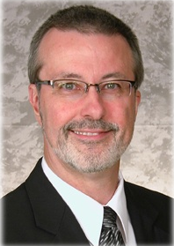
Mark Wright, OD, FCOVD
CEO: Pathways to Success for Optometrists
Editor: Review of Optometric Business
CEO: Practice Management Center
Board: Association of Practice Management Educators
Director of the OSU College of Optometry Business Management Program
Author: Coding, Reimbursement and Contracting for Optometry
1980 – 2007 founder and senior partner Professional VisionCare, Westerville, Ohio
Notes:
3
3
Dr. Wright is a 1980 graduate of The Ohio State University College of Optometry, where he is clinical assistant professor and faculty coordinator of OSU’s Business Management Program. Retired from practice last year, Dr. Wright is president of Pathways to Success, Eyecare Business Training and Progressive Publishing Company. All three of these companies are dedicated to the special practice management needs of eyecare practices. Dr. Wright has lectured extensively throughout the U.S. and abroad. His topics include not only practice management, but also managed care, sports vision and vision and traumatic brain injuries. He is also the practice management editor for the Journal of Optometric Vision Development. This is Mark’s first presentation to the MBA. Please welcome Mark Wright…

Slide 4
SPEAKER FINANCIAL DISCLOSURE STATEMENT
Mark R. Wright, OD, FCOVD has been a paid speaker for the following companies:
  Alcon
  B&L
  ESSILOR
  Jobson
  Transitions
  Vistakon
  VSP
He is an officer of:
  Pathways to Success
  Practice Management Center
  Association of Practice Management Educators
  Progressive Publishing Company
He is the professional editor of:
  Review of Optometric Business
Diversified Ophthalmics
Eye Recommend
IDOC
IVA
PECAA
PERC
Vision Source
Walman

Slide 5
Here’s where the course lives
Optometrybusiness.com
RESOURCES

Slide 6
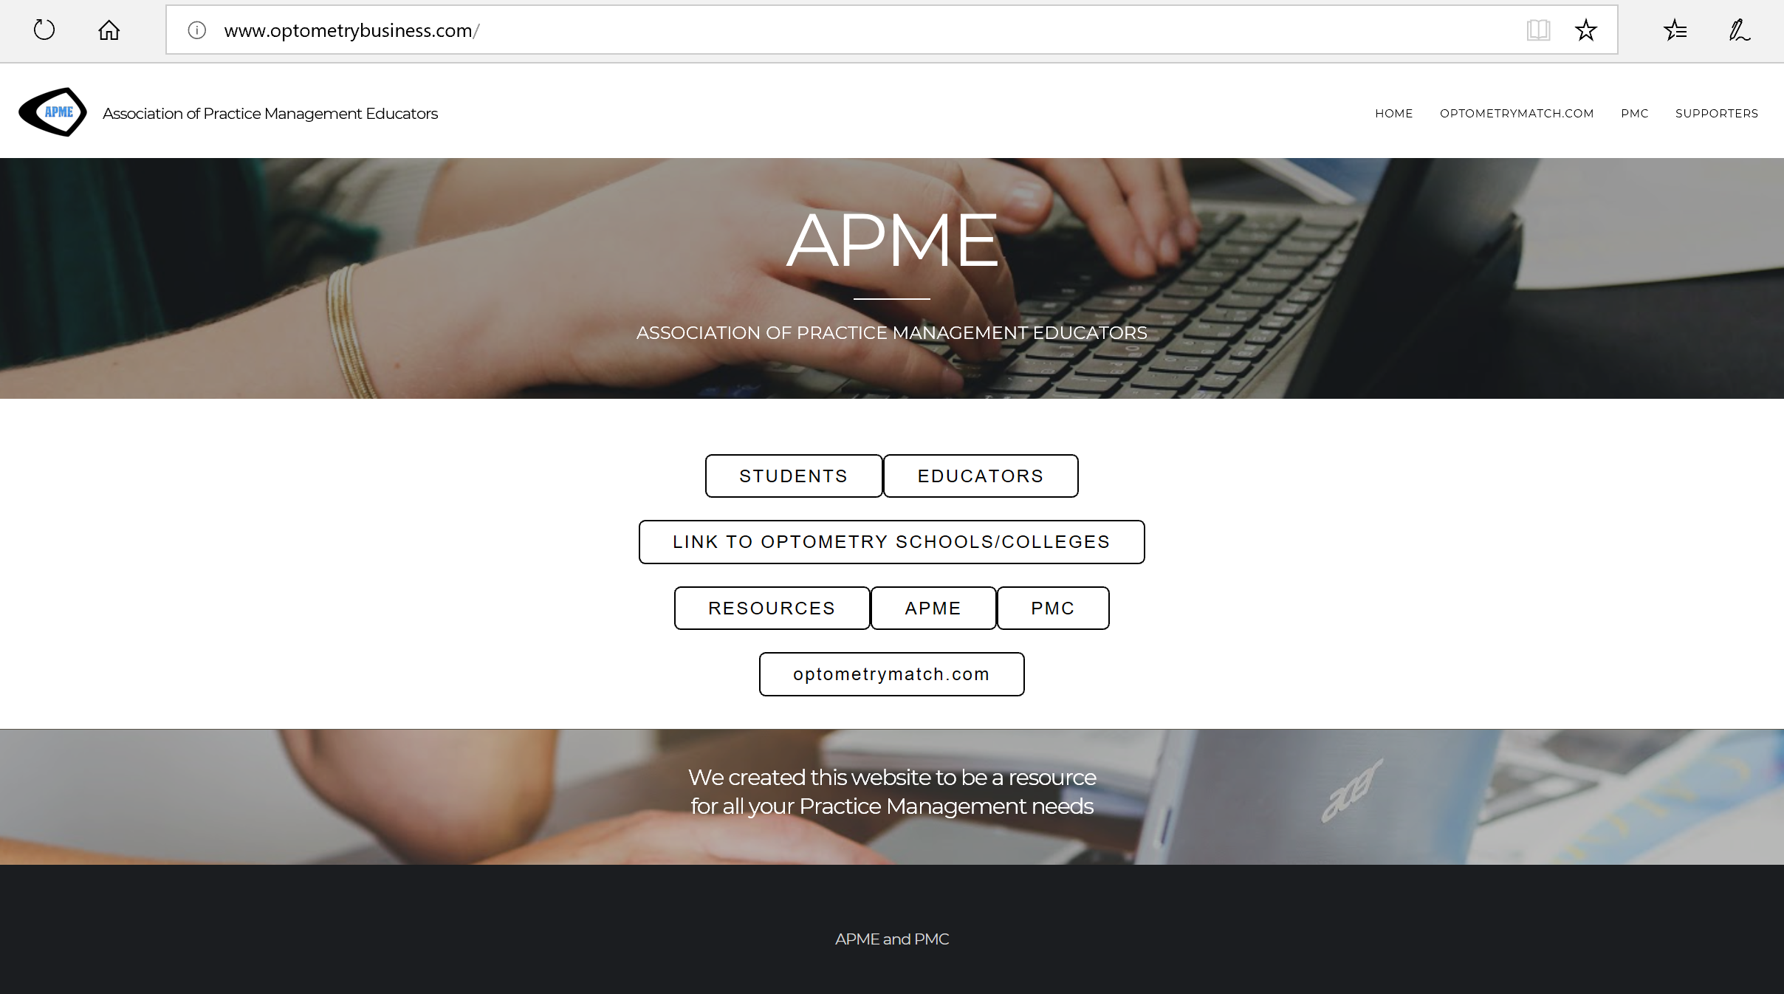

Slide 7
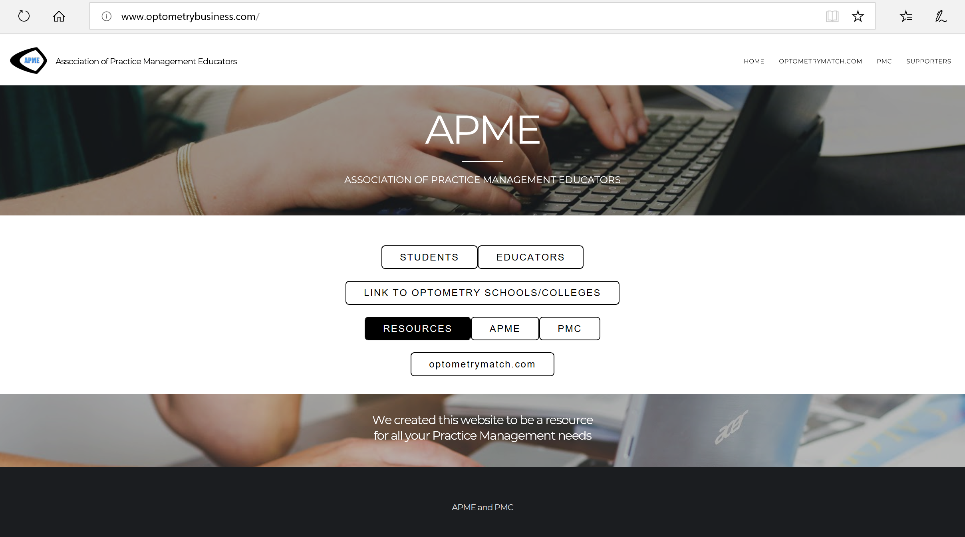

Slide 8
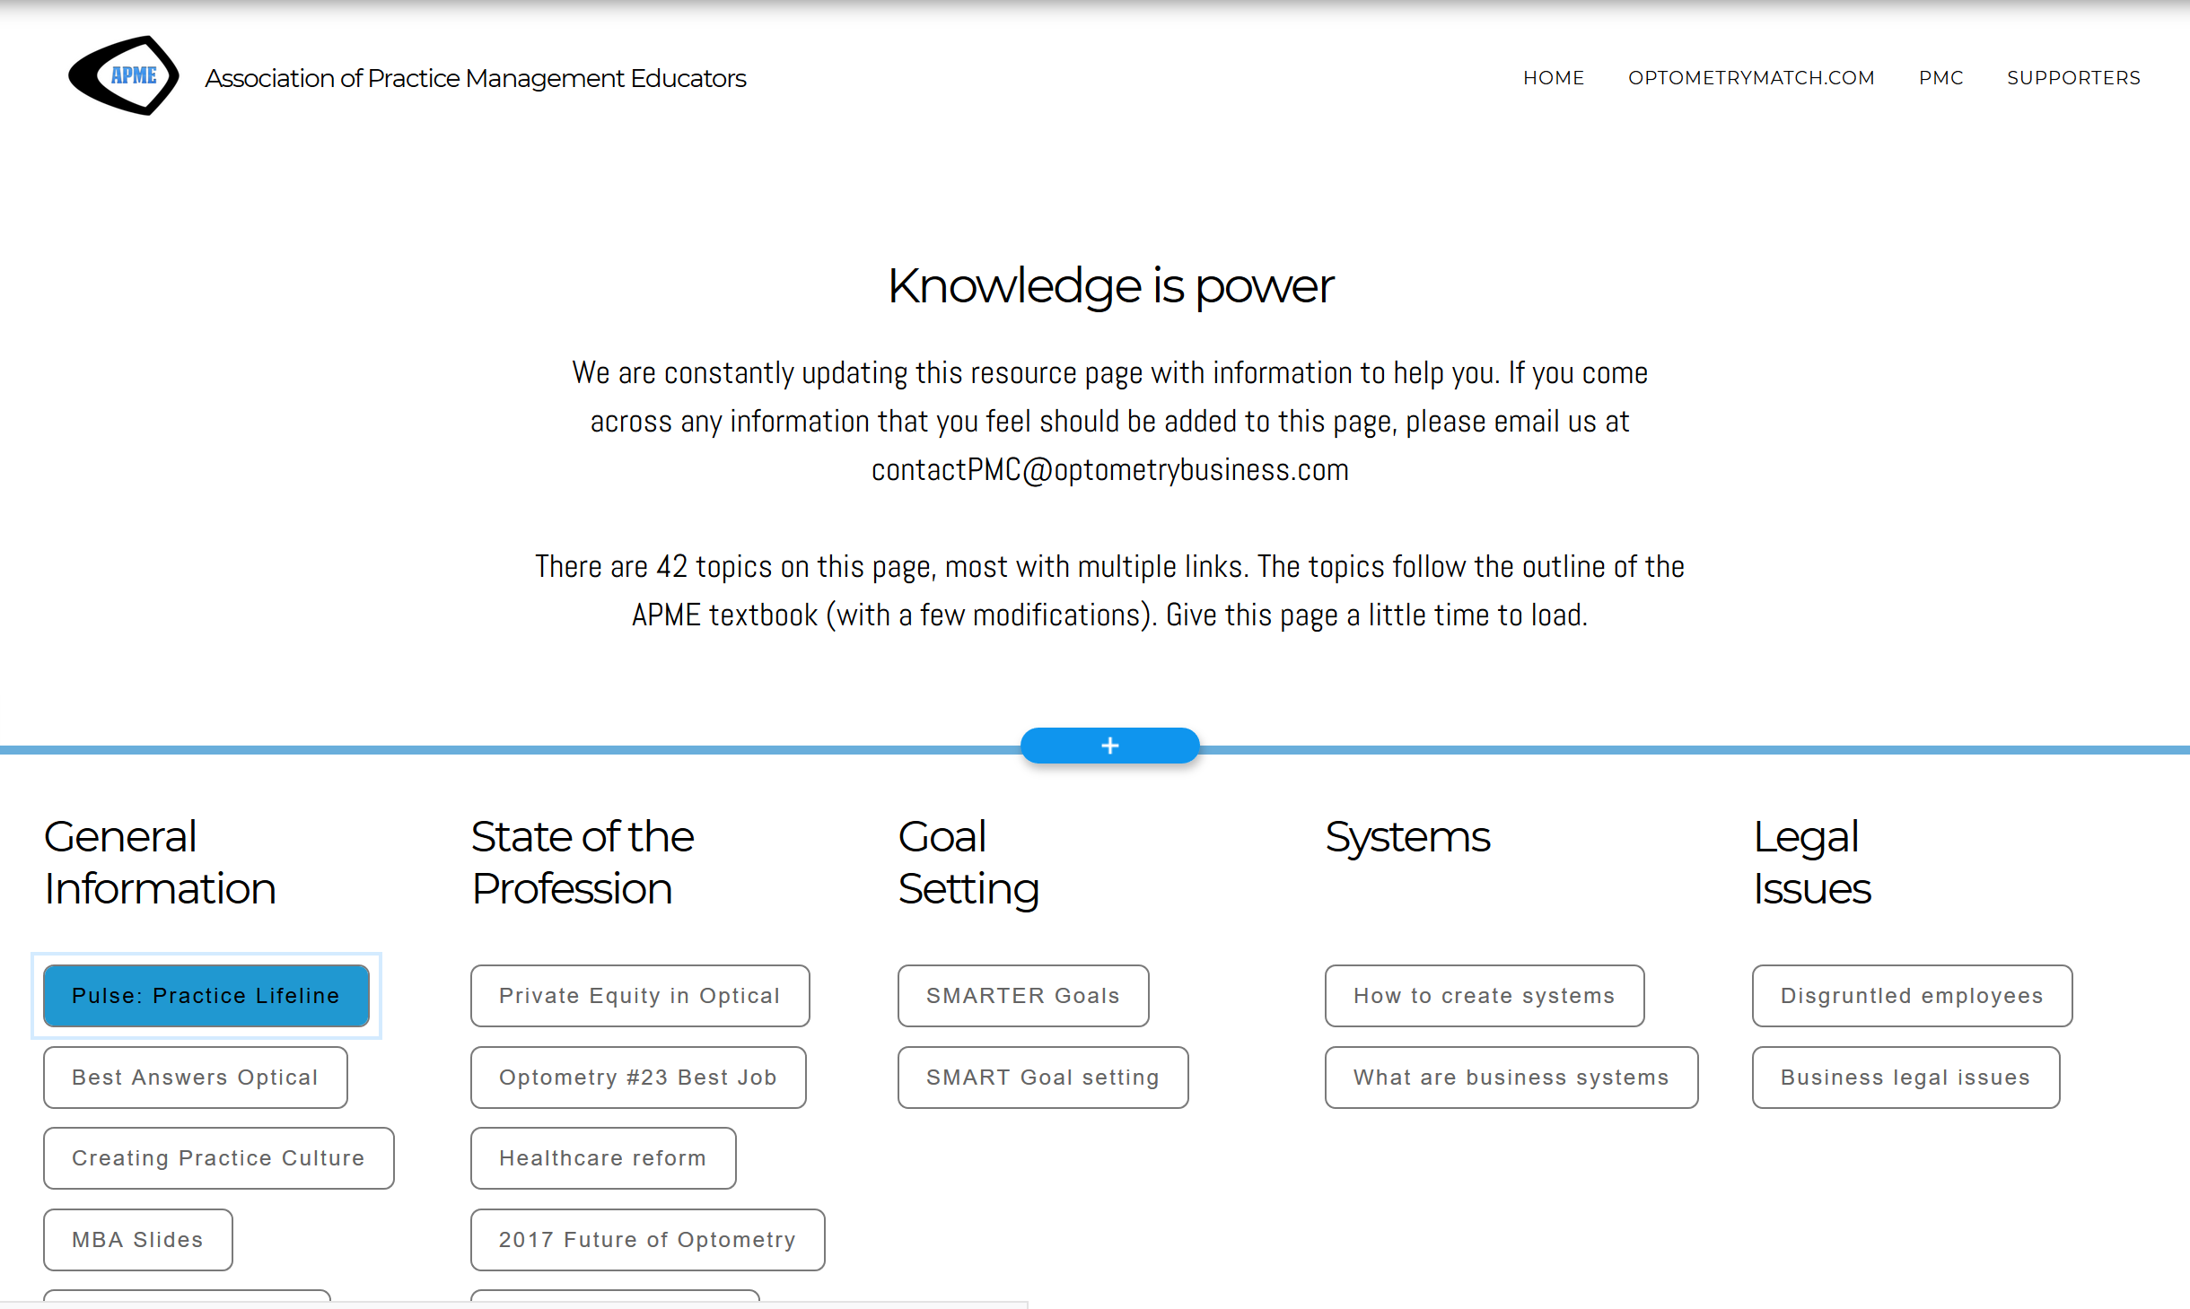

Slide 9
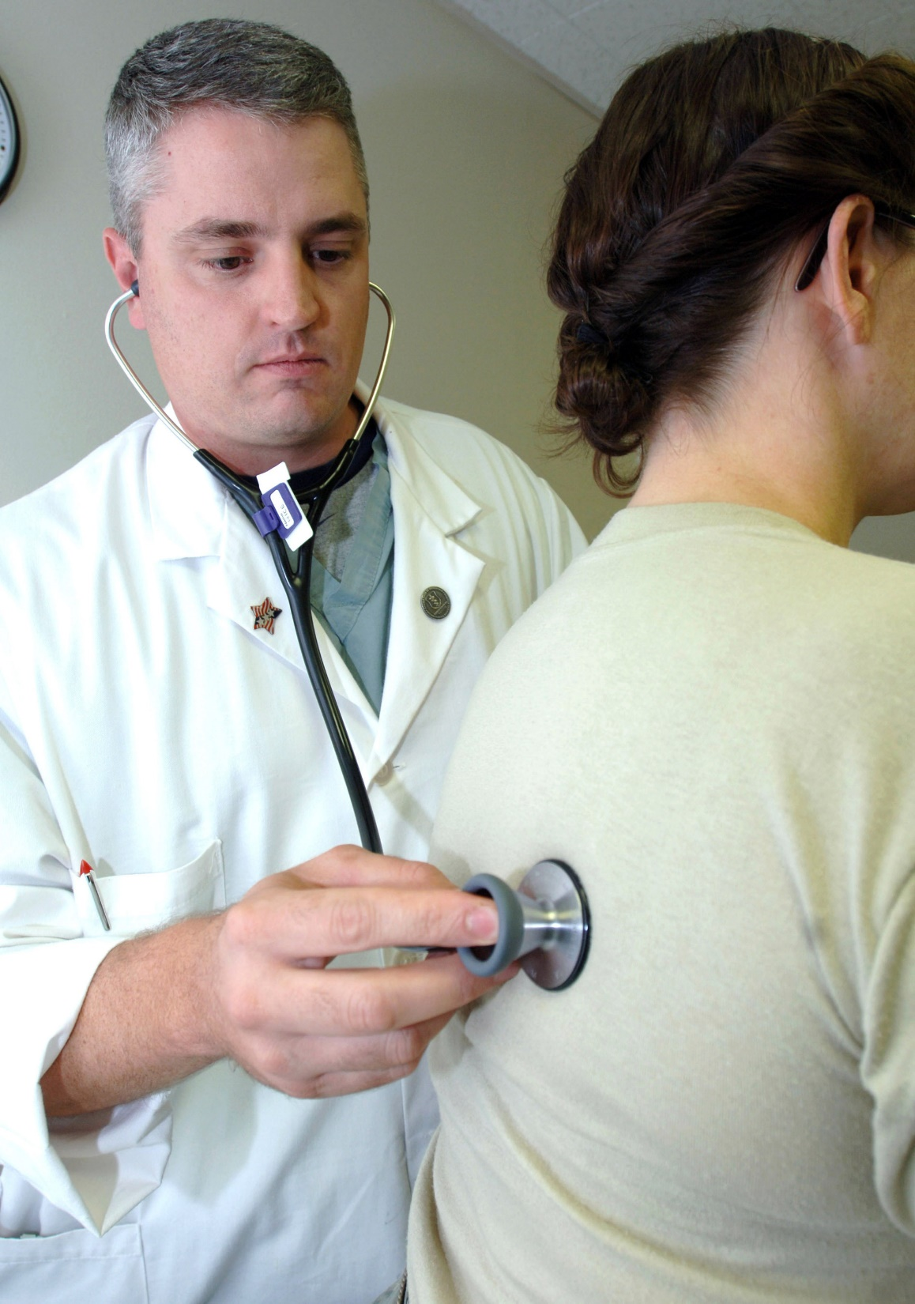

Vital Signs
Pulse
Blood pressure
Weight
Height
Body temperature
There are 5 pieces of data we’d like you to monitor to evaluate the health of your practice.
These Vital Signs will give you the Pulse of your practice
Notes:
Here is the data we’d like you to monitor. Just like checking your weight, temperature, blood pressure or pulse! Hence the name of today’s presentation. we can evaluate the health of your practice by examining these 5 factors. MBA 306 median practice 4-500 per patient top 10%. It’s been stable over 7 years. All sources per pt.
Look at what you did in 2015 and increase 2016
Track these 5 numbers and improve them.
PM computer software vs pull out 100 files Contact Compulink and officemate and tell them you want these 5 numbers in reports. May cost $75.

Slide 10
Vital Signs
Increase Dollars per Comp Exam
Increase Capture Rate
Increase Multiple Pair Sales
Increase Number of New Patients
Increase Expense Management
If our vital signs aren’t increasing, increasing we are dying…
Notes:
Here is the data we’d like you to monitor. Just like checking your weight, temperature, blood pressure or pulse! Hence the name of today’s presentation. we can evaluate the health of your practice by examining these 5 factors. MBA 306 median practice 4-500 per patient top 10%. It’s been stable over 7 years. All sources per pt.
Look at what you did in 2015 and increase 2016
Track these 5 numbers and improve them.
PM computer software vs pull out 100 files Contact Compulink and officemate and tell them you want these 5 numbers in reports. May cost $75.

Slide 11
Make it easy!
Contact software co & tell them you want these 5 vital signs in reports.
Vital Signs
Increase Dollars per Comp Exam
Increase Capture Rate
Increase Multiple Pair Sales
Increase Number of New Patients
Increase Expense Management
Look at what you did last year and make this year better
If our vital signs aren’t increasing, increasing we are dying…
Notes:
Here is the data we’d like you to monitor. Just like checking your weight, temperature, blood pressure or pulse! Hence the name of today’s presentation. we can evaluate the health of your practice by examining these 5 factors. MBA 306 median practice 4-500 per patient top 10%. It’s been stable over 7 years. All sources per pt.
Look at what you did in 2015 and increase 2016
Track these 5 numbers and improve them.
PM computer software vs pull out 100 files Contact Compulink and officemate and tell them you want these 5 numbers in reports. May cost $75.

Slide 12
$ indicate care delivered
Do you believe every patient should have multiple glasses?
People purchase what they value.

Slide 13


Slide 14
MBA $306 median practice
(top 10%) $400-600 per patient
Vital Signs
Increase Dollars per Comp Exam
Increase Capture Rate
Increase Multiple Pair Sales
Increase Number of New Patients
Increase Expense Management
If our vital signs aren’t increasing, increasing we are dying…
Notes:
Here is the data we’d like you to monitor. Just like checking your weight, temperature, blood pressure or pulse! Hence the name of today’s presentation. we can evaluate the health of your practice by examining these 5 factors. MBA 306 median practice 4-500 per patient top 10%. It’s been stable over 7 years. All sources per pt.
Look at what you did in 2015 and increase 2016
Track these 5 numbers and improve them.
PM computer software vs pull out 100 files Contact Compulink and officemate and tell them you want these 5 numbers in reports. May cost $75.

Slide 15

Increase Dollars per Comp Exam
How to Calculate
Total $ / Total # of Exams (with billable refractions) = Avg. $ per Exam
MBA: $306 median practice
(top 10%) $500-$600 per Exam

Slide 16
Best Practices
ODs Rx multiple pairs in the exam room
Train staff how to close the deal with Dr’s Rx (assumptive sale)
If sales of frames retailing for $200 or more is less than 40% of units, increase inventory of higher end frames
Compare exam fees to industry norms. If exam fee is at or below industry median, consider increasing fees
Upgrade optical dispensary
Bundle Pricing vs al la carte pricing

Slide 17
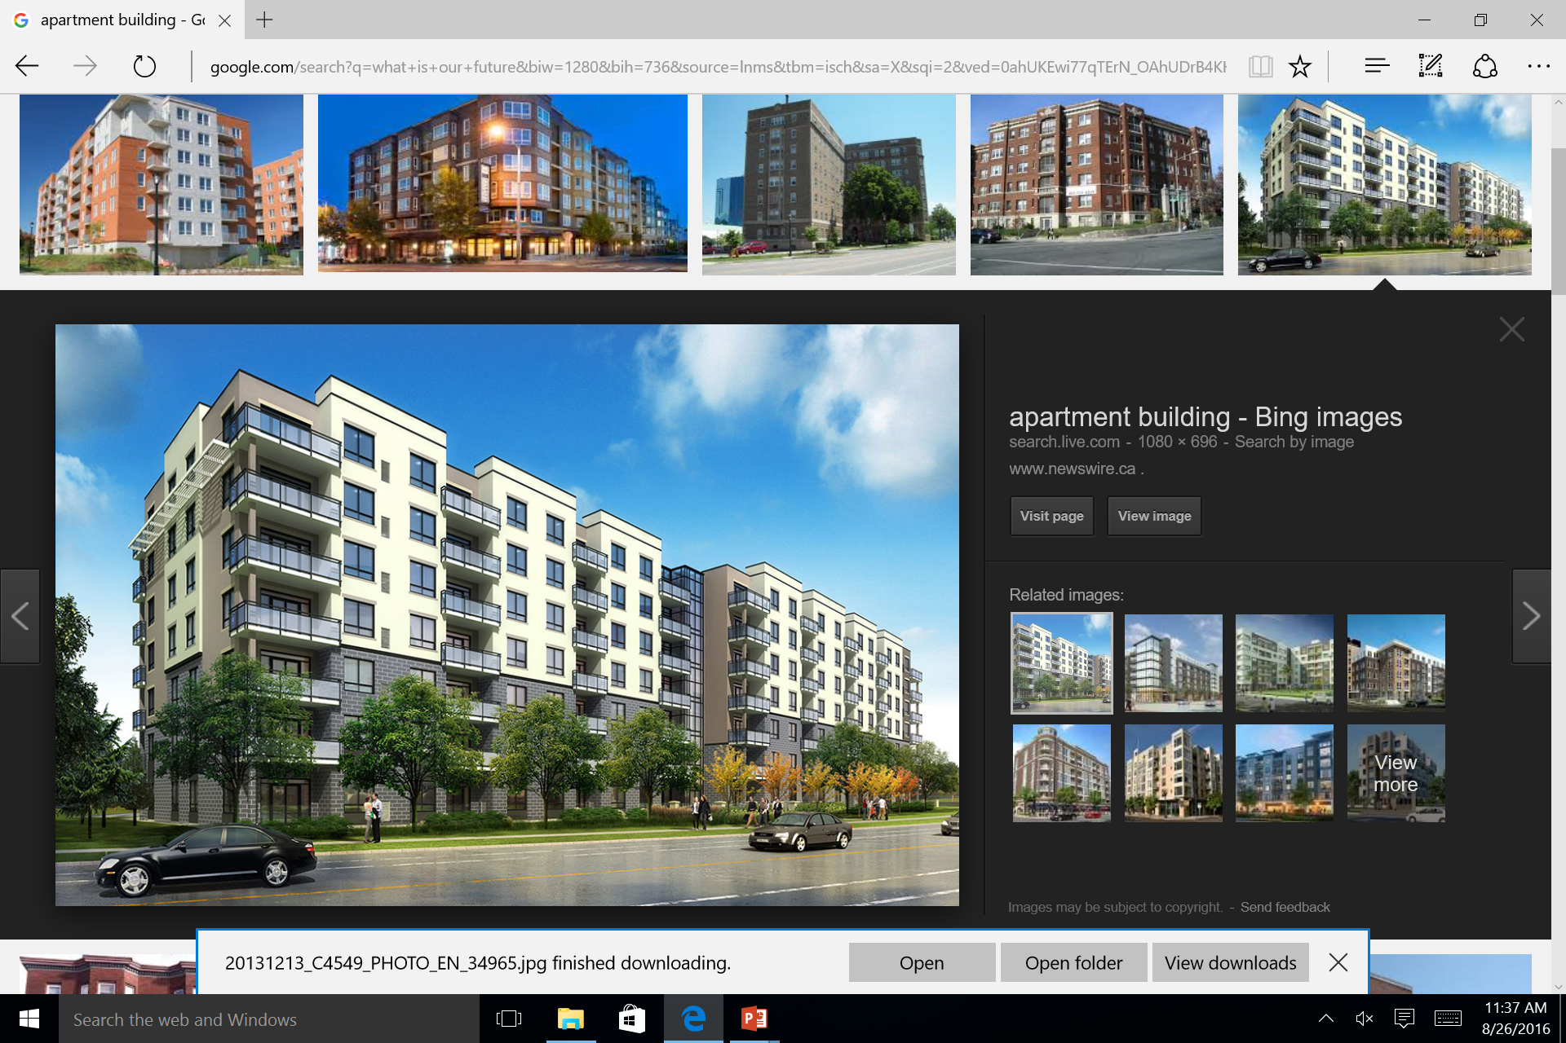

Slide 18
Units Sold

Slide 19
Math for previous slide
# Sold | Ave price | Total $
100 | $50 | $5,000
150 | $125 | $18,750
200 | $175 | $35,000
250 | $225 | $56,250
175 | $275 | $48,125
90 | $325 | $29,250
50 | $375 | $18,750
25 | $425 | $10,625
10 | $475 | $4,750
Total $ Frame Sales |  | $226,500
Practice Gross Revenue |  | $1,132,500
(Total Frame Sales/.2)

Slide 20
FRAMEBOARD DISTRIBUTION
$0-200 22%
$201-280 37%
$281-360 18%
$361-449 13%
> $450 10%
MEN’S
WOMEN’S
UNISEX
FASHION FORWARD
CONTEMPORARY
CONSERVATIVE

Slide 21
EASE Study
Enhancing the Approach to Selecting Eyewear
Method
Some 91 patients with no previous contact lens experience were split into two groups. One was offered contact lenses before spectacle dispensing. The other proceeded to spectacle dispensing without being offered contact lenses.
Results
Some 88 percent of the group offered contact lenses agreed to try them; 98 percent of them were successfully fit.
  Superior subjective spectacle dispensing experience
  Spent 32% more on their spectacles
  33% in CLs compared with 13%
*Atkins NP, et al. Enhancing the approach to selecting eyewear (EASE): A multi-centre, practice-based study into the effect of applying contact lenses prior to spectacle dispensing. Contact Lens & Anterior Eye (2009), doi:10.1016.

Slide 22
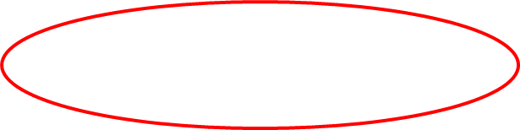
Monthly income converting one lined bifocal to a Premium PAL per day
$510 x 20 x 12 = $124,400
$970 x 20 x 12 = $232,800!
Income converting one lined bifocal to a pair of Premium PAL clear and sun lenses a day:

Slide 23

Transitions
40% intend to purchase
20% purchase

Slide 24
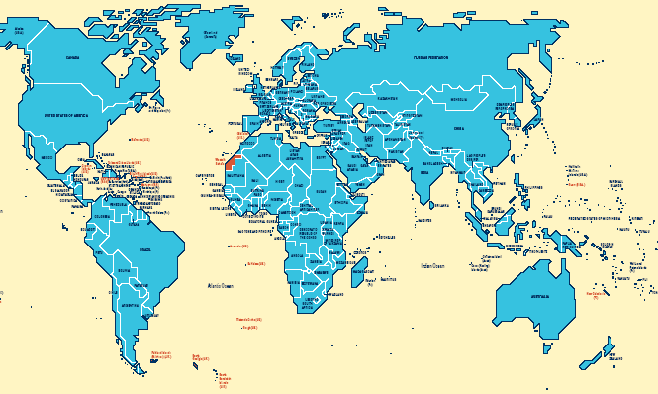
AR Lenses around the World
Canada
63%
Japan
100%
United States
20%
Europe
50+%
Korea
100%
Brazil
27%
Photo/Graphic Courtesy of Essilor of America
Notes:
Around the world we see a wide variety of results. In the mature Asian AR markets we see market share of 95% - 98%. Why are these results so much higher than in the United States? Very simply other markets have maintained much higher levels of glass lenses. And AR on glass has historically produced more durable results than AR on resins. In addition Asian markets have a higher usage of thin, flat, higher index lens materials. It is almost essential that flat lenses be Anti-reflective to minimize the increased surface reflections of flatter lenses.
Europe at 50+% is almost double the United States. As with Asia, Europe still uses more glass than the USA and higher index resins outsell CR-39.
Canada is following Europe’s foot steps while South America is growing and almost on-par with the USA.
Industry sources peg our AR lens sales between 28 to 35percent in the US. For purposes of this session we’ve settled on 29 percent.
DISCUSSION: “WHAT IS YOUR AR PERCENTAGE?”

Slide 25
Educate the Patient about lenses before the visit
Staff & Doc wear glasses- give testimonials
At patient check-in receptionist mentions new lenses
Educate in the reception area
Include ?’s related to need for lenses in history form
Technician reviews history and gives lens information
Technician relates lens feature to pre-testing
Doctor relates to history and exam to possible lens solutions
Doctor prescribes in exam room, offers best to everyone
Hands off patient to Optician, repeat Tx
Optician demonstrates, presents packaged pricing
Restate benefits and value at dispensing

Slide 26
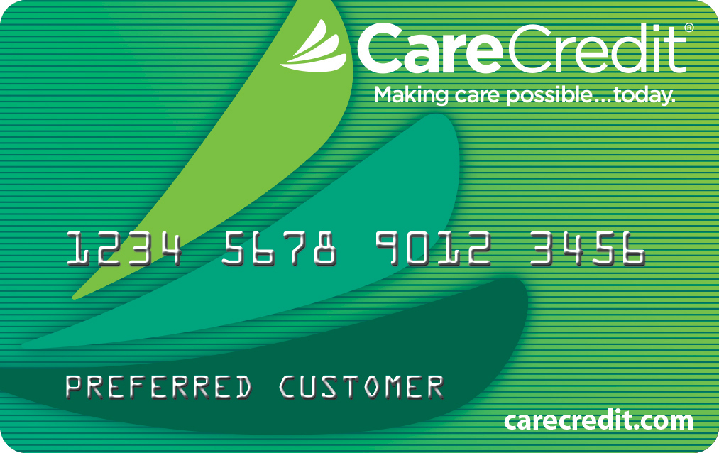
Optical
Reception

Slide 27

Entering the Optical
Explain your guarantee
Polarized lens demonstration
Select Lens
Select Frame
Let’s see what your insurance benefits contribute

Slide 28
Did you know?
79% of people know that they need to use skin protection when exposed to the sun
6% of people know that they need to protect their eyes
Notes:
As a matter of course, did you realize that 79% of people knew that they needed to use skin protection when exposed to the sun but do you have any idea what percentage of people knew that they also needed to protect their eyes?

Slide 29
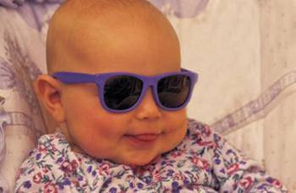
32%
Most Recent AOA Survey
Nearly one-third (32 percent) of children go a full hour using technology before they take a visual break instead of every 20 minutes as recommended.
http://www.aoa.org/newsroom/survey-reveals-parents-drastically-underestimate-the-time-kids-spend-on-electronic-devices?sso=y

Slide 30
Optometric Oath
“I will advise my patients fully and honestly of all which may serve to restore, maintain, or enhance their vision and general health”

Slide 32
Vital Signs
Increase Dollars per Comp Exam
Increase Capture Rate
Increase Multiple Pair Sales
Increase Number of New Patients
Increase Expense Management
If our vital signs aren’t increasing, increasing we are dying…
Notes:
Here is the data we’d like you to monitor. Just like checking your weight, temperature, blood pressure or pulse! Hence the name of today’s presentation. we can evaluate the health of your practice by examining these 5 factors. MBA 306 median practice 4-500 per patient top 10%. It’s been stable over 7 years. All sources per pt.
Look at what you did in 2015 and increase 2016
Track these 5 numbers and improve them.
PM computer software vs pull out 100 files Contact Compulink and officemate and tell them you want these 5 numbers in reports. May cost $75.

Slide 33
Capture Rate
OD Rx in exam room
Staff trained on closing techniques
Assumptive Close
Puppy Dog Close
Take Away Close
https://www.thebalancecareers.com/closing-sales-techniques-2918610
Exit interview patients

Slide 35
Vital Signs
Increase Dollars per Comp Exam
Increase Capture Rate
Increase Multiple Pair Sales
Increase Number of New Patients
Increase Expense Management
If our vital signs aren’t increasing, increasing we are dying…
Notes:
Here is the data we’d like you to monitor. Just like checking your weight, temperature, blood pressure or pulse! Hence the name of today’s presentation. we can evaluate the health of your practice by examining these 5 factors. MBA 306 median practice 4-500 per patient top 10%. It’s been stable over 7 years. All sources per pt.
Look at what you did in 2015 and increase 2016
Track these 5 numbers and improve them.
PM computer software vs pull out 100 files Contact Compulink and officemate and tell them you want these 5 numbers in reports. May cost $75.

Slide 36
Change your language
Recommend, Suggest, Offer
Prescribe

Slide 37
Home
School
Work
Play

Slide 38
What happens when you prescribe more?
Prescribe 1 | Get 1
Prescribe 2 | Get 1, sometimes 2
Prescribe 3 | Get 2, sometimes 3
Prescribe 4 | Get 3, sometimes 4

Slide 40
Vital Signs
Increase Dollars per Comp Exam
Increase Capture Rate
Increase Multiple Pair Sales
Increase Number of New Patients
Increase Expense Management
If our vital signs aren’t increasing, increasing we are dying…
Notes:
Here is the data we’d like you to monitor. Just like checking your weight, temperature, blood pressure or pulse! Hence the name of today’s presentation. we can evaluate the health of your practice by examining these 5 factors. MBA 306 median practice 4-500 per patient top 10%. It’s been stable over 7 years. All sources per pt.
Look at what you did in 2015 and increase 2016
Track these 5 numbers and improve them.
PM computer software vs pull out 100 files Contact Compulink and officemate and tell them you want these 5 numbers in reports. May cost $75.

Slide 41

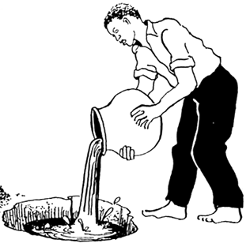

Why do you need new patients?
Every year 5 – 10% of your patients die or move away

Slide 42

# of New Patients
Ask for patients
Digital Marketing Program
Loyal patients vs Satisfied patients

Slide 43


Slide 44
What is a brand promise?
A brand promise is a statement made by an organization to its customers stating what customers can expect from their product and services.

Slide 45
3 Great Examples of a Brand Promise
The NFL: “To be the premier sports and entertainment brand that brings people together, connecting them socially and emotionally like no other.”
Coca-Cola: “To inspire moments of optimism and uplift.”
Virgin: “To be genuine, fun, contemporary, and different in everything we do at a reasonable price.”

Slide 46
What is your brand promise?

Slide 47

Data Mining Customer Data

Slide 48
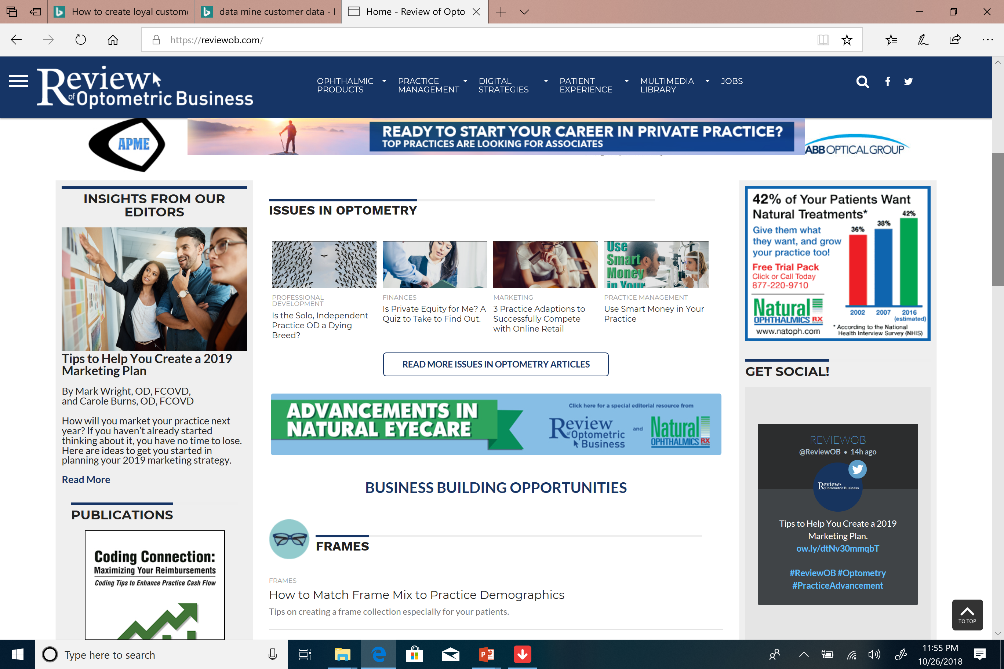
reviewob.com

Slide 49
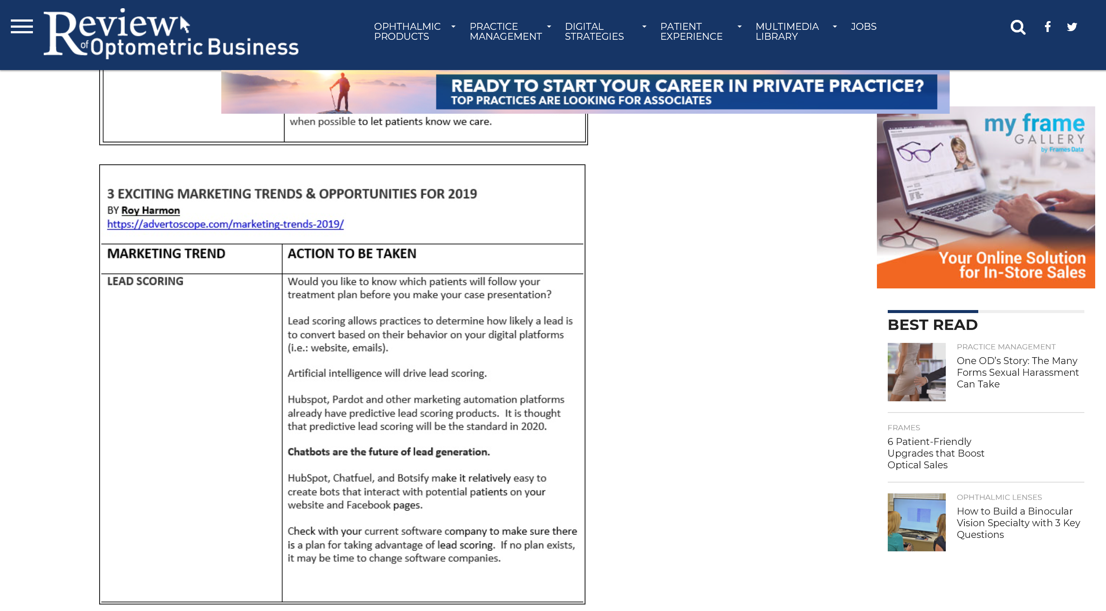
Lead Scoring

Slide 50
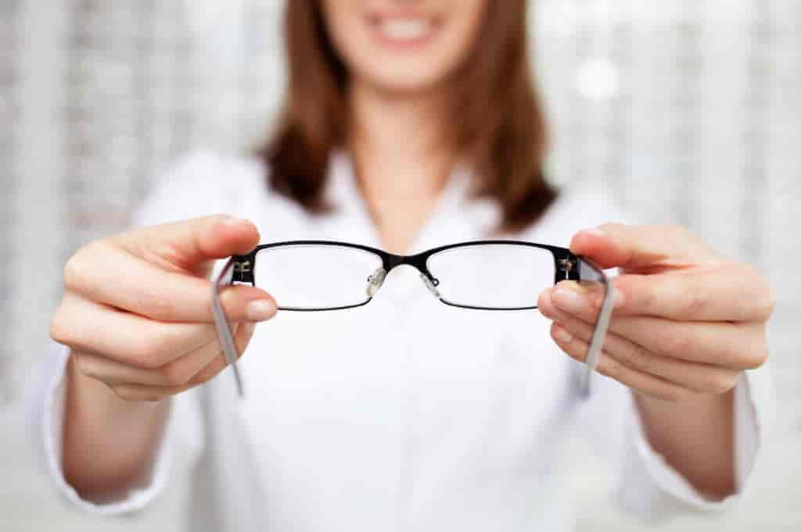
Highly Personalized Customer Service
What does it look like in your practice to pick up your new glasses?

Slide 51

Call Center

Slide 53
Vital Signs
Increase Dollars per Comp Exam
Increase Capture Rate
Increase Multiple Pair Sales
Increase Number of New Patients
Increase Expense Management
If our vital signs aren’t increasing, increasing we are dying…
Notes:
Here is the data we’d like you to monitor. Just like checking your weight, temperature, blood pressure or pulse! Hence the name of today’s presentation. we can evaluate the health of your practice by examining these 5 factors. MBA 306 median practice 4-500 per patient top 10%. It’s been stable over 7 years. All sources per pt.
Look at what you did in 2015 and increase 2016
Track these 5 numbers and improve them.
PM computer software vs pull out 100 files Contact Compulink and officemate and tell them you want these 5 numbers in reports. May cost $75.

Slide 54
Increase Expense Management
EXPENSE
Cost of Goods | 25%
Staff Payroll | 20%
Occupancy | 10%
Clinical Equipment | 01%
Marketing | 01%
Overhead | 10%

Slide 55
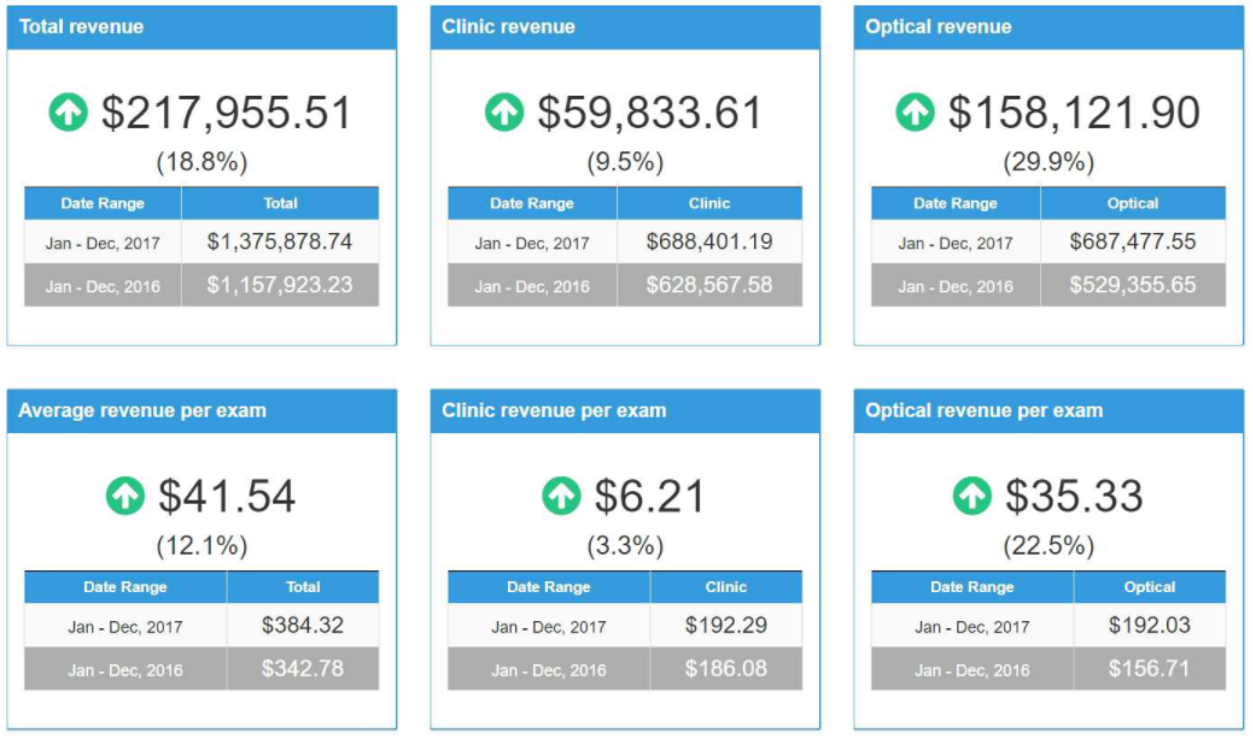
What STATs do we want to follow
Total Revenue
Clinic Revenue
Optical Revenue
Total Revenue
  Clinic Revenue
  Optical Revenue
Ave $/Exam
  Clinic $/Exam
  Optical $/Exam
Ave Revenue / Exam
Clinic Revenue / Exam
Optical Revenue / Exam

Slide 56
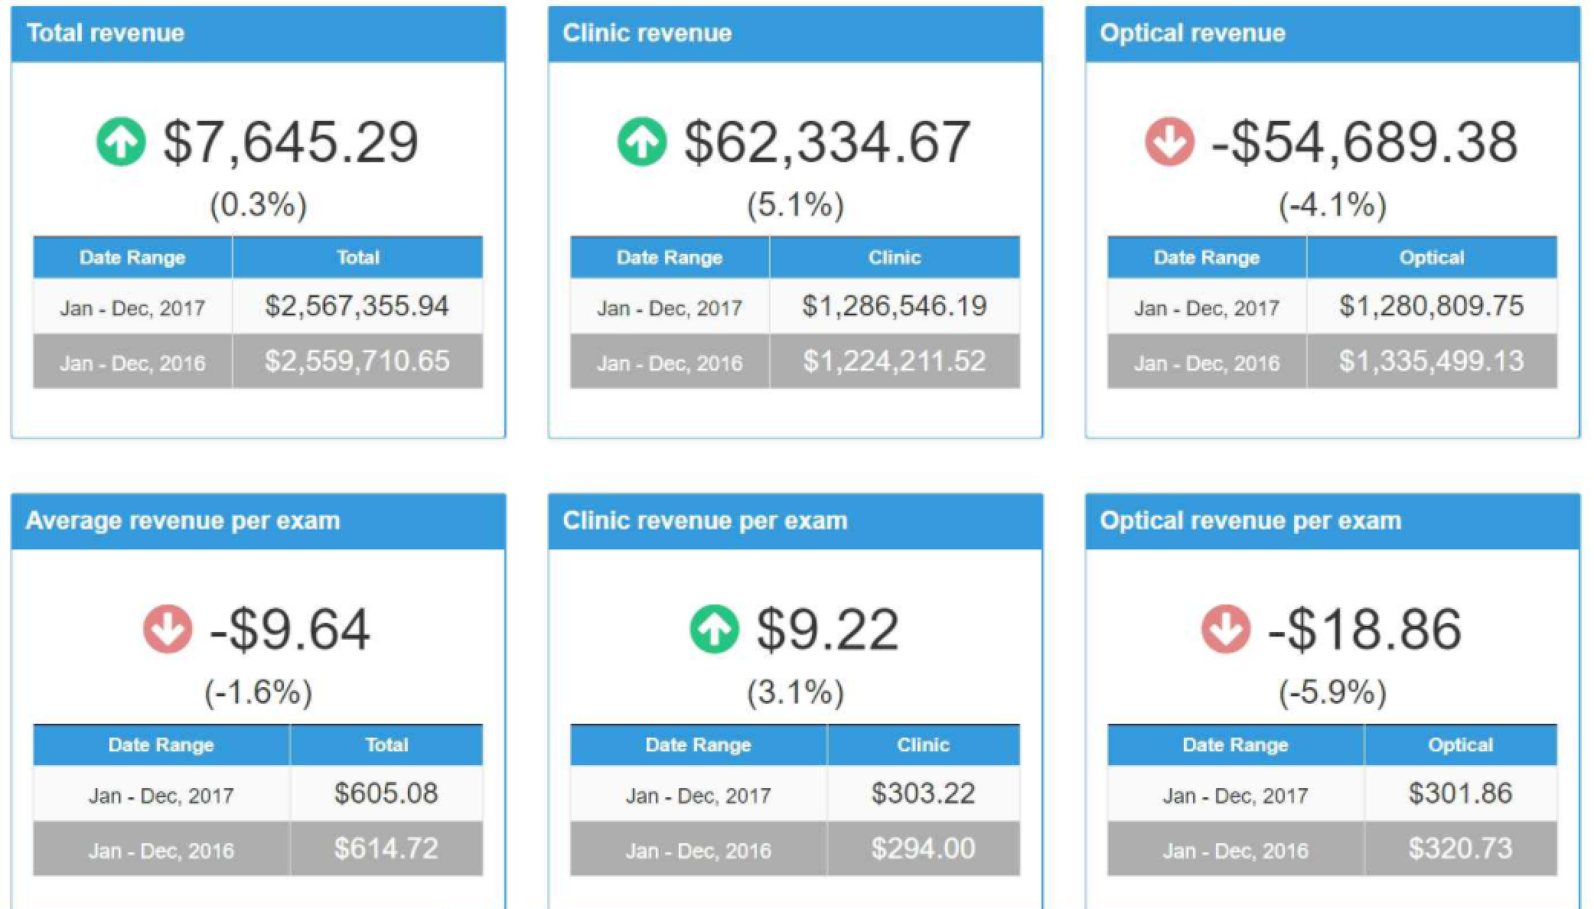
What STATs do we want to follow
Total Revenue
Clinic Revenue
Optical Revenue
Total Revenue
  Clinic Revenue
  Optical Revenue
Ave $/Exam
  Clinic $/Exam
  Optical $/Exam
Ave Revenue / Exam
Clinic Revenue / Exam
Optical Revenue / Exam

Slide 57
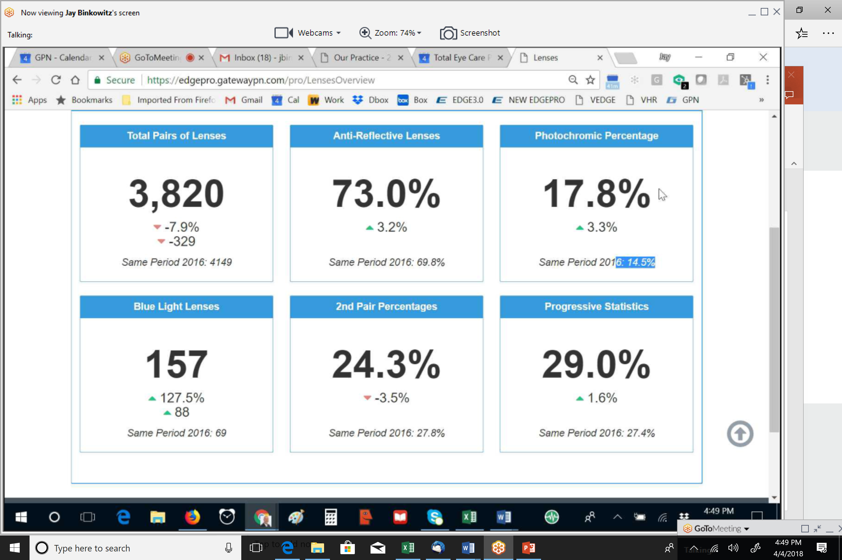
What other STATS to measure
Total Lens Pairs
AR Lens %
Photochromic %
Blue Light
2nd Pair %
Progressives %
Total Lens Pairs
AR Lenses %
Photochromic %
Blue Light
2nd Pair %
Progressives

Slide 58
Total Revenue
Clinic Revenue
Optical Revenue
Total Lens Pairs
AR Lenses %
Photochromic %
Ave $ / Exam
Clinic $ / Exam
Optical $ / Exam
Blue Light
2nd Pair %
Progressives

Slide 59
Practice 1 Practice 2
All 6 Green 3 Green, 3 Red

Slide 60
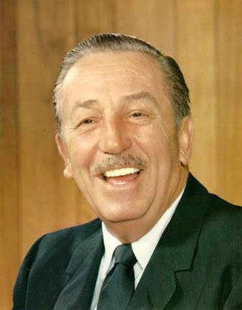
Service
Successful practices set astonishing high standards of performance.
They are obsessed with knowing what the patient wants.
They design their services to maximize patient satisfaction.

Slide 61
Service
They try to be an easy company to do business with.
They emphasize that customer service is the responsibility of everyone in the organization.
Ask your staff, “What your end product?”

Slide 62

The RATER Model was created by professors Valarie Zeithaml, A. Parasuraman, and Leonard Berry, and published in their book, "Delivering Quality Service."

Slide 63
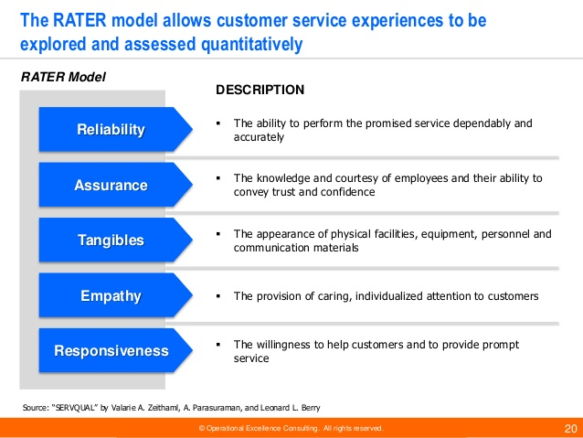

Slide 64

Moments of Truth
Critical encounter points with a practice that can shape a patient’s impression.
Touch Points
Pulse Points

Slide 65
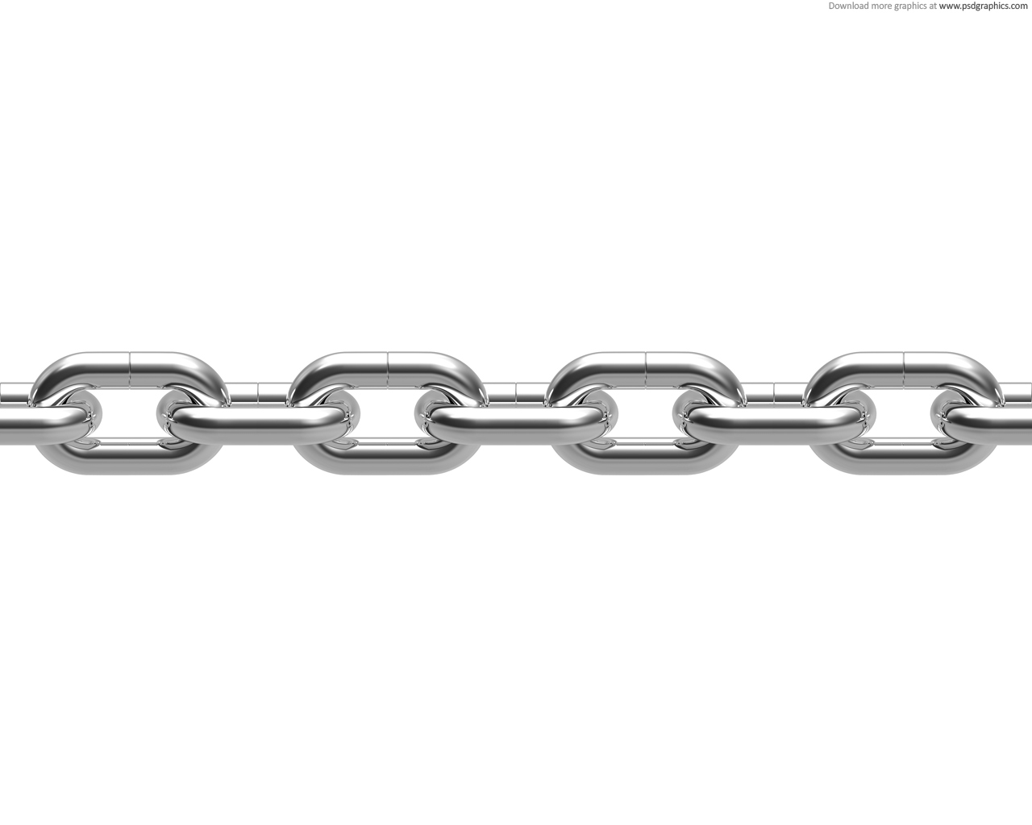
Disney’s
Chain of Excellence
LEADERSHIP
EXCELLENCE
CAST
EXCELLENCE
SERVICE
EXCELLENCE
BUSINESS
EXCELLENCE

Slide 67
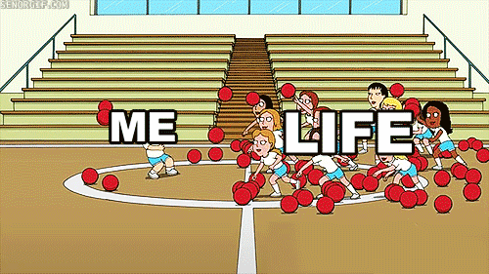

Slide 68


Slide 69


Slide 70
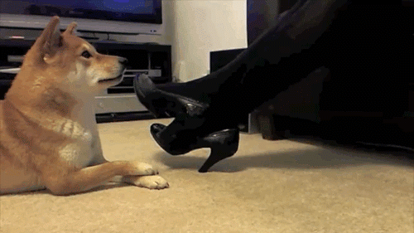

Slide 71

The Ritz Carlton
Thank You for the opportunity to share ideas with you!
Mark Wright, OD, FCOVD
mwright@pathways-o.com
Provide high quality care and your practice will grow,
patients, staff and doctors will benefit
Notes:
Story listening to guy : RC hires people to clean rooms like all hotels, and speech they give is the guy stands in front and says I know you have worked for ….and been taught to clean a hotel room, but you have never been taught to clean it the RC way. So I know you have been an optiican etc for 2 years but you have never been taught to do this in a xxxx practice. Our goal is to provide high quality care, and our practice grows, then walman business grows, they etc that is why we are here tonight, and don’t forget priority thing.

Slide 72
